Slide 1



Data Demons
EDUSCAN
A one stop solution for OCR and centralised database
Presented by DataDemons

Slide 2


﻿About the project
EduScan is an innovative and user-friendly solution designed to streamline the process of submitting handwritten answer sheets to the university server securely. In today's digital age, where handwritten assignments and examinations still hold significance, EduScan bridges the gap between traditional and digital learning environments.

Slide 3

Security
EduScan prioritize the security and confidentiality of your academic work. EduScan employs 256-bit AES encryption protocol to ensure that the scanned content is transmitted securely to the university server. Rest assured, the data is protected from unauthorized access throughout the entire upload process.

Slide 4
Key Features
1
Security
2
Handwriting Transformation
3
Integration

Slide 5

Handwriting Recognition
One of the standout features of EduScan is its powerful handwriting recognition technology. We leverage ML algorithms to convert handwritten text into digital, editable formats. This makes it easier for professors and educators to review, grade, and provide feedback on assignments, quizzes, and exams.
The proposed system proves to be more than 90% efficient.

Slide 6
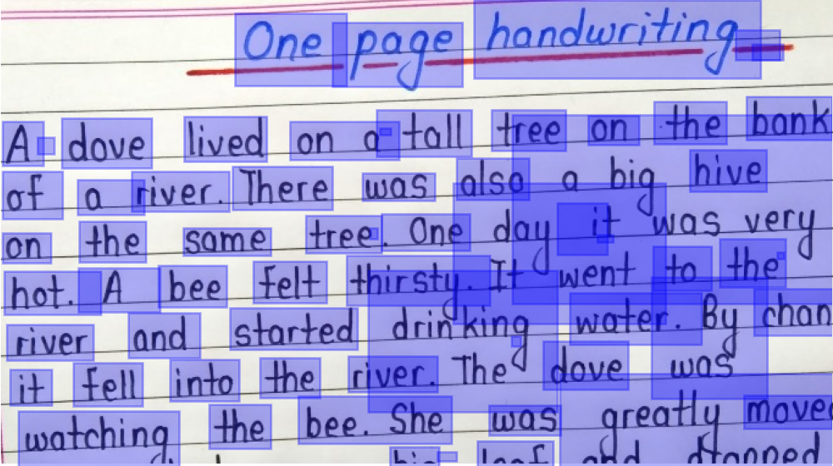
Integration
User File Upload: The Flask application allows students to upload scanned answer sheets in PDF format. This is crucial as it enables students to submit their scanned answer sheets electronically.
Server-Side Processing: The application handles the server-side processing of the uploaded PDF files. It saves the uploaded PDF files to a designated folder on the server (uploads/pdf), ensuring secure storage.
Database Storage: The application uses POSTGRES SQL to create and manage a database to store information about the uploaded PDF files. This includes the filename and an associated unique identifier (ID). This database allows the university to keep track of which students have submitted their answer sheets and retrieve them when needed.
Security: The application uses Flask-Uploads to manage file uploads securely. It also inserts the uploaded file information into the SQLite database, which helps in auditing and tracking the submitted answer sheets.
Feedback to Users: When a PDF is successfully uploaded and stored, the application returns a message ("PDF uploaded and stored successfully!"). Providing feedback to users is essential for a user-friendly experience.
OCR Conversion: While this code handles the file upload and storage aspect, it doesn't perform OCR (Optical Character Recognition) to convert handwriting to text. You would need to integrate OCR software or services into your application to achieve this functionality.

Slide 7
PROTOTYPE

Slide 8
﻿THANK YOU

